Slide 1
The Project Demonstration and Documentation
Project Demonstration Requirements
Project Demonstration Marking Matrix
Project Documentation Requirements
Formal Proposal Marking Matrix

Slide 2
Project Demonstration Requirements
Book a time for presenting your project
BE AVAILABLE 15 MINUTES BEFORE YOUR TIME SLOT!
Mount your project on a platform, such as a piece of wood or perspex.
Indicate your PROJECT TITLE, NAME, SURNAME, and STUDENT NUMBER clearly on the project – print it and cut it out to ensure a neat finish. NO PROJECT WILL BE ACCEPTED WITHOUT IS!
Label the different sections of your project, i.e. TRANSMITTER, RECEIVER, CONVEYOR, SENSOR, etc. – again print it and cut it out to ensure a neat finish.
Print a copy of the Project Presentation Marking Matrix.pdf file and fill in your student name and number on the sheet. Bring this with you for the presentation.

Slide 3
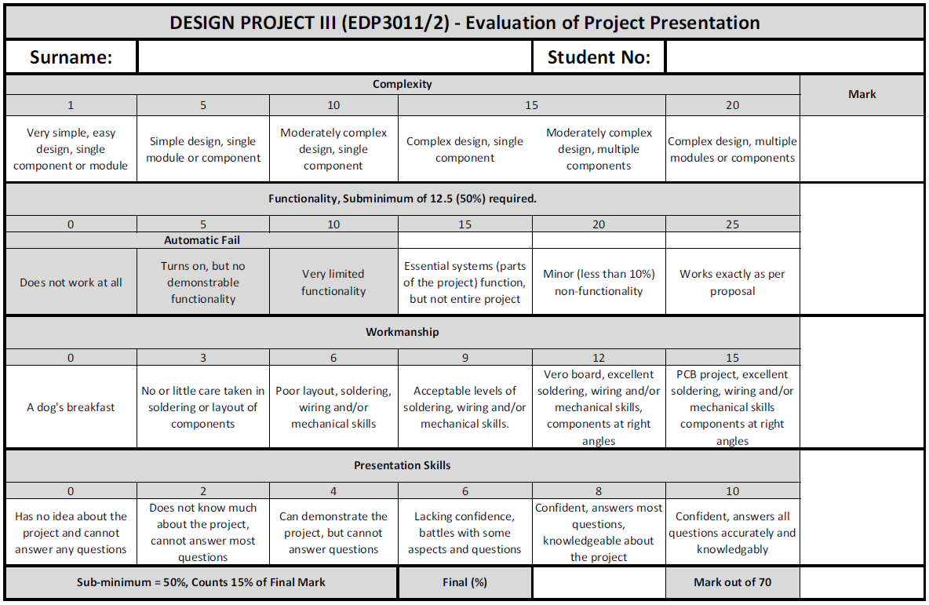
Project Demonstration Marking Matrix

Slide 4
Project Documentation Requirements
Create a MS Word document that contains the following:
(see the “Project Documentation Template.doc” file)
The document should be ring-binded or something similar to create a professional look.
Attach a copy of the Project Documentation Marking Matrix.pdf as the SECOND page and fill in your student name and number and NMMU mentor name on the sheet.
Email a copy of this document to your NMMU mentor – make sure the attachment is in the format:
surname – student number – Documentation.doc
e.g. Ferreira - 20102321 - Documentation.doc

Slide 5
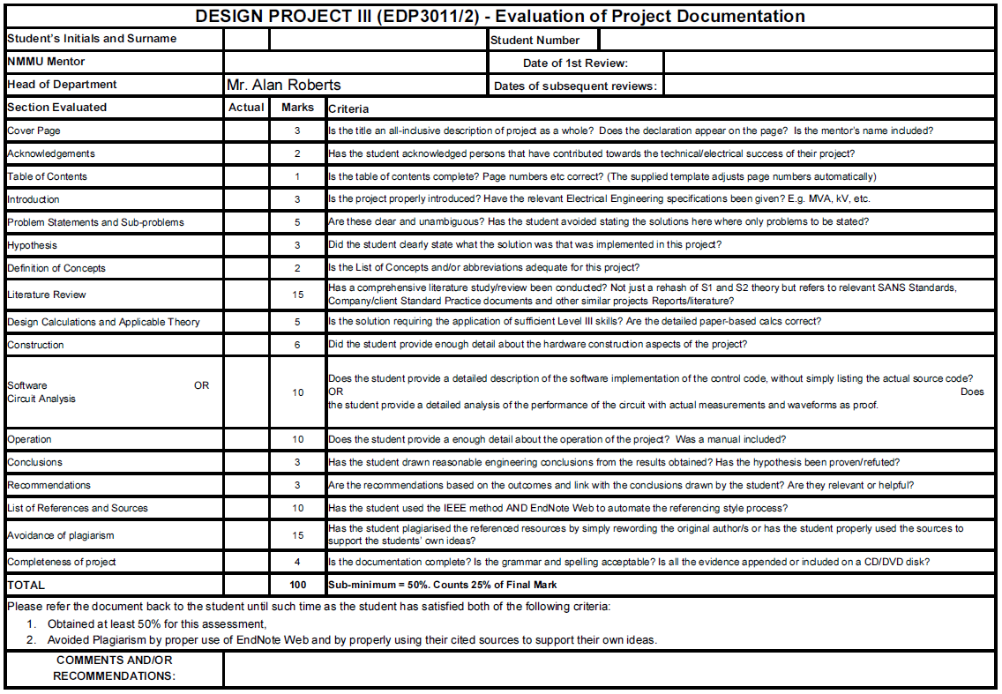
Project Documentation Marking Matrix

